Slide 1
Liberal Event Extraction and Event Schema Induction
Lifu Huang, Taylor Cassidy, Xiaocheng Feng,
Heng Ji, Clare R. Voss, Jiawei Han, Avirup Sil
Rensselaer Polytechnic Institute, US Army Research Lab,
Harbin Institute of Technology, Univerisity of Illinois at Urbana-Champaign,
IBM T.J. Watson Research Center <acl2016>

Slide 2
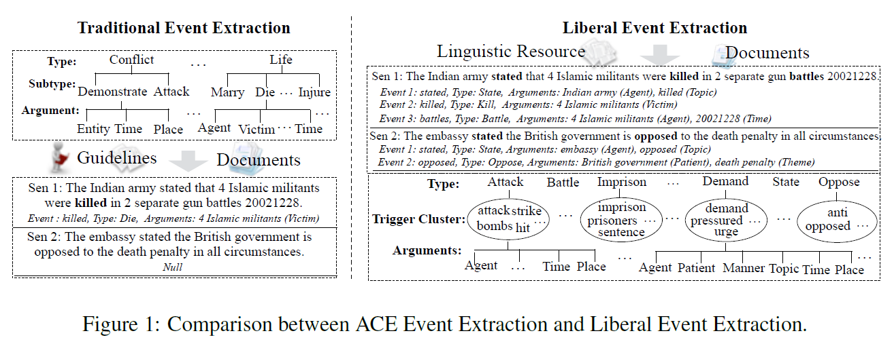
Introduction
Event extraction aims at identifying and typing trigger words and participants (arguments).
event schema : types of triggers and types of the arguments and the relations among these types
Traditional event extraction and Liberal event extraction

Slide 3
Problem
Manually-defined event schemas often provide low coverage and fail to generalize to new domains.

Slide 4
Goal:
Extract the events and discover the event schemas from free text

Slide 5
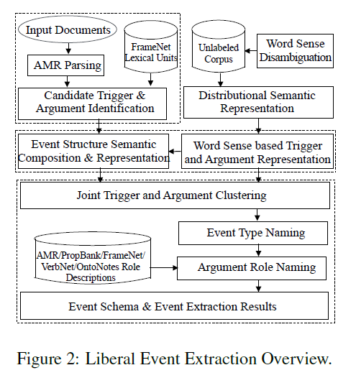
Approach

Slide 6
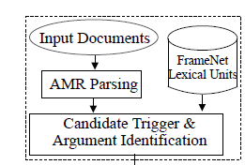
Candidate Trigger and Argument Identification
Candidate event triggers:
Candidate arguments

Slide 7
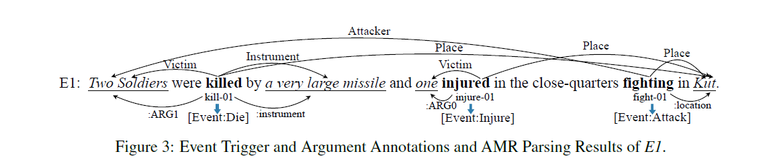
Candidate Trigger and Argument Identification
Candidate event triggers: All noun and verb words that are assigned an OntoNotes sense by WSD(word sense disambigution) tool in a given a sentence
Argument Identification: derived from three meaning representation : AMR, FrameNet, and Stanford Typed Dependencies

Slide 8
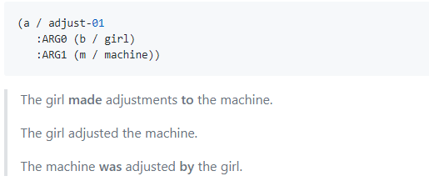
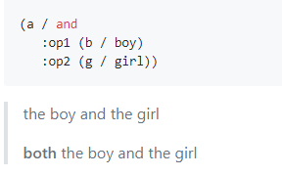
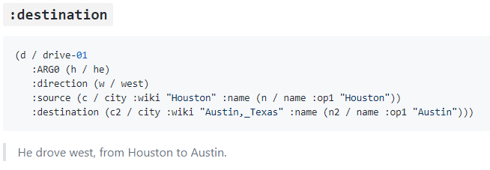
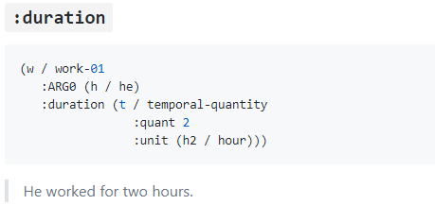
AMR(Abstract Meaning Representation)
AMR tool captures “who is doing what to whom” in a sentence.

Slide 9
Frame-semantic parser based on FrameNet
Frame-semantic parser for automatically detecting semantic frames and their arguments, with the respective labels, from text.
Github: https://github.com/Noahs-ARK/open-sesame.git

Slide 10
Candidate Trigger and Argument Identification
Candidate triggers: “killed”, “injured” and “fighting”
Candidate arguments: “{Two Soldiers, very large missile}”, “{one, Kut}” and “{Two Soldiers, Kut}”,

Slide 11
Approach

Slide 12
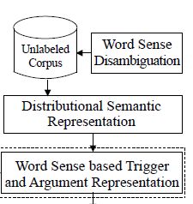

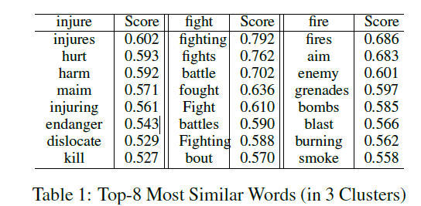
Trigger Sense and Argument Representation

Slide 13
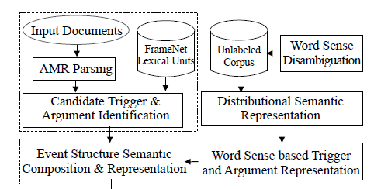
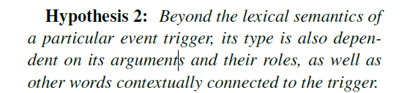
Event Structure Composition and Representation

Slide 14
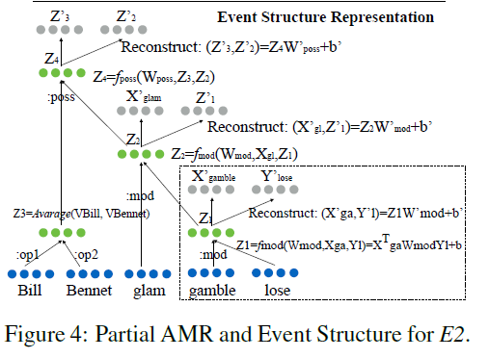
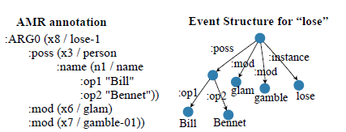
E2: Bill Bennet’s glam gambling loss changed my opinion.

Slide 15
Approach

Slide 16
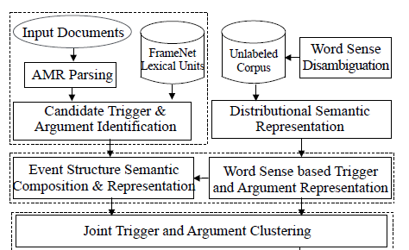

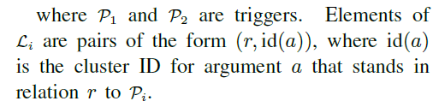
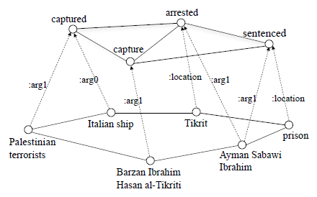
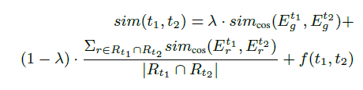

Joint Trigger and Argument Clustering
Similarity:

Slide 17
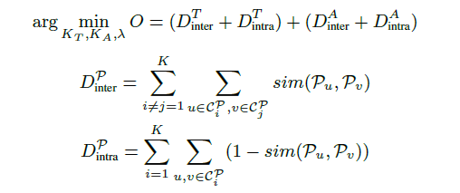
Joint Trigger and Argument Clustering
Spectral Clustering algorithm
Optimize

Slide 18
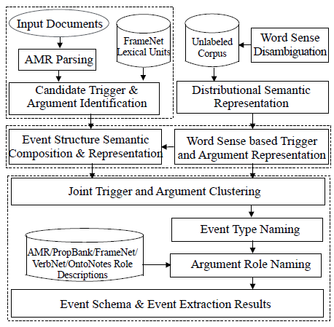
Event Type and Argument Role Naming
Event type : for each trigger cluster, we utilize
the trigger is nearest to the centroid of the
cluster as the event type name.

Slide 19
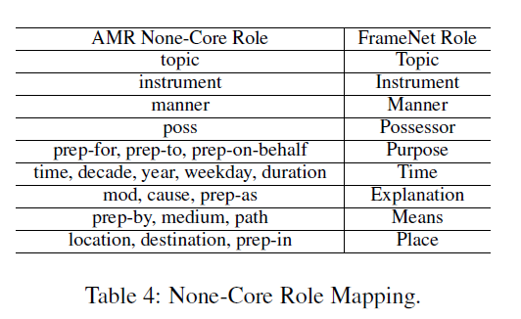
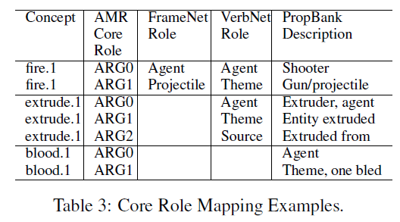
Event Type and Argument Role Naming
Argument Role name:

Slide 20
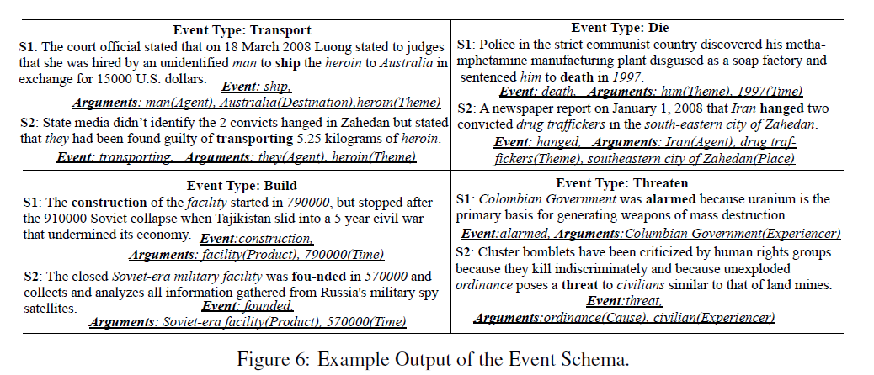

Slide 22
Thanks

